Slide 1
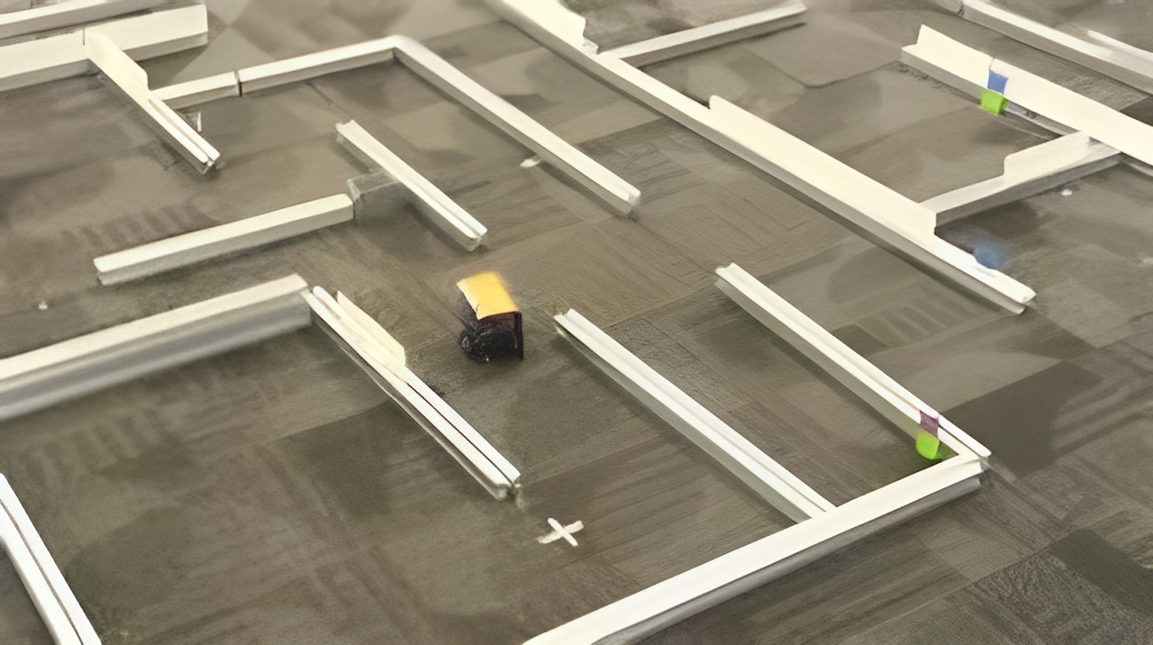
RAPIDLY Exploring RANDOM TREE (RRT & RRT*) Algorithm for path planning
VIPUL PRAJAPATI
SUNIL KODI

Slide 2
PERCEPTION
BEHAVIOUR
CONTROL

Slide 3
PERCEPTION
BEHAVIOUR
CONTROL

Slide 4
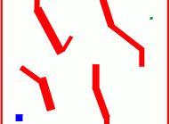
Problem statement
Given a “configuration space” we need to find an efficient path between a start point and a destination in a context of robotics and autonomous system

Slide 5

Introduction
Overview
Path planning involves finding a feasible and optimal path from a starting point to a goal in a given environment.
Essential for the navigation of robots and autonomous systems in dynamic and static environments.
Significance
Navigation
Collision Avoidance
Mapping
Obstacle Avoidance
Efficiency
Data Transmission

Slide 6
Performance measure
Environment
Actuator
Sensors
Path Length
Smoothness
Safe
Avoidance of obstacles
State of robot or a system with obstacles
Exp. Robot in a room or free space with obstacles
Wheels
Castor wheel
Display
Camera
Lidar
Radar
UV sensor

Slide 7
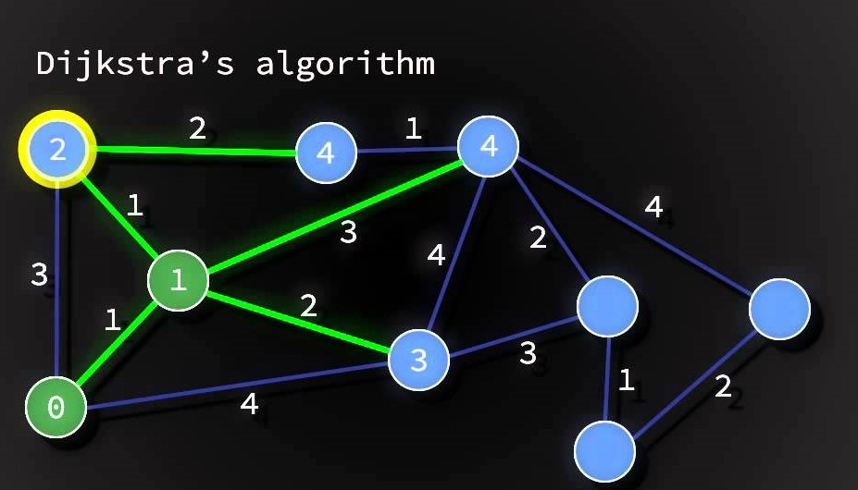
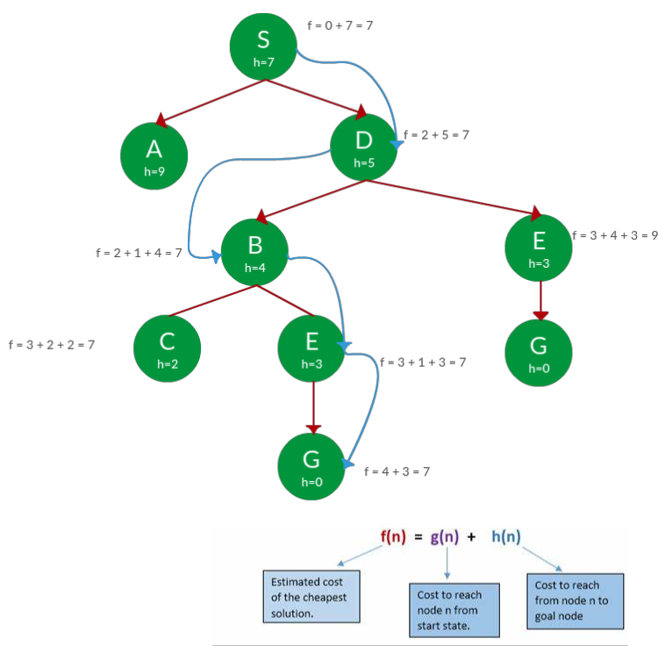
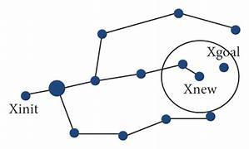
algorithms
Dijkstra
A*
RRT & RRT*

Slide 8
comparison
Algorithm | pros | cons | completeness | Optimality | Applicability
Dijkstra's | Guarantees shortest path, Simple implementation | Inefficient in high-dimensional/dynamic spaces, No heuristics | Complete | Optimal | Static environment
A* | Admissible and efficient with heuristic, Optimality under conditions | Heuristic-dependent, Memory-intensive for large graphs/high dimensional state space | Complete | Optimal with heuristic | Static with good heuristic environment

Slide 9
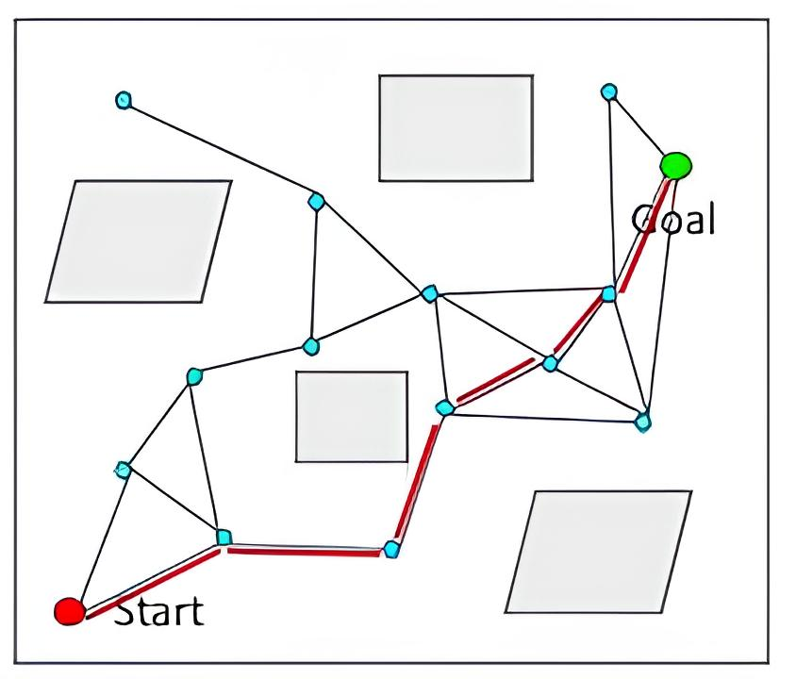
Sampling based method for path planning
Sampling-based algorithms are well-suited for high-dimensional spaces and complex environments.
Instead of exhaustively searching the entire configuration space, these methods make decisions based on randomly sampled points.
The idea is to build a feasible path by connecting sampled points in the configuration space.
They are probabilistically complete, meaning they have a high likelihood of finding a solution if one exists.
Particularly effective in scenarios with obstacles or narrow passages where traditional methods may struggle.

Slide 10
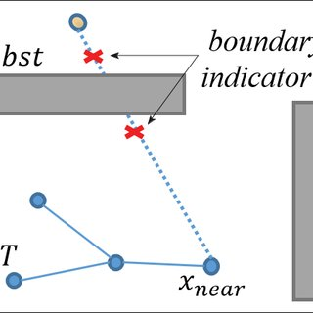
Rapidly exploring random tree (Rrt) – sample based
It focuses on rapidly exploring the configuration space to construct a tree-like structure.
Start with an initial configuration and grow the tree by iteratively extending it towards randomly sampled configurations.
This exploration strategy efficiently covers the configuration space, providing a feasible path from the start to the goal.
It may struggle in narrow passages or high-dimensional spaces, leading to inefficient paths.
The algorithm might not fully exploit the configuration space, resulting in non-optimal solutions.
High-dimensional spaces pose challenges in terms of computational efficiency and exploration effectiveness.

Slide 11
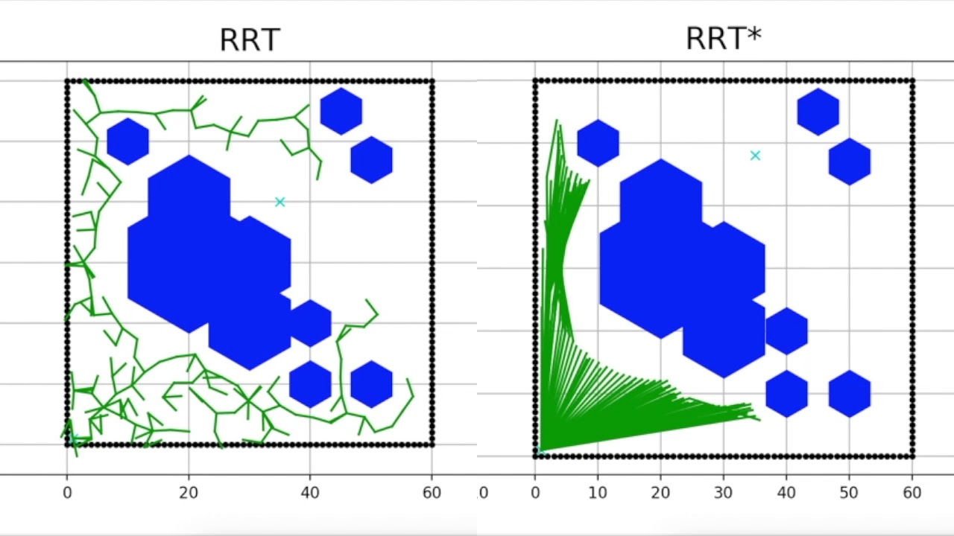
Rrt* algorithm
RRT* is an enhanced version of RRT designed to address the limitations of basic RRT.
It introduces a rewiring step, an improved tree structure, and a cost function to overcome the limitations of basic RRT.
After adding a new node, RRT* checks if rewiring connections can lead to a more optimal path, enhancing exploration efficiency.
RRT* uses a more structured tree, allowing for better coverage of the configuration space.
The cost function guides the exploration towards lower-cost paths, promoting optimality.

Slide 12
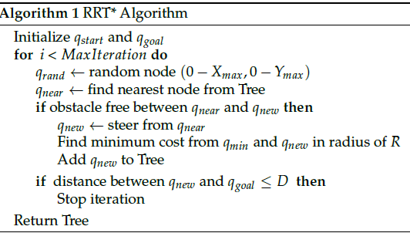
Rrt* algorithm

Slide 13

Implementation

Slide 14

Time complexity
Time complexity of RRT* can be stated as O(K * log(N)), where:
K is the dimensionality of the configuration space/time complexity of the operations performed within each iteration
N is the number of iterations or nodes in the RRT* tree.

